Slide 1
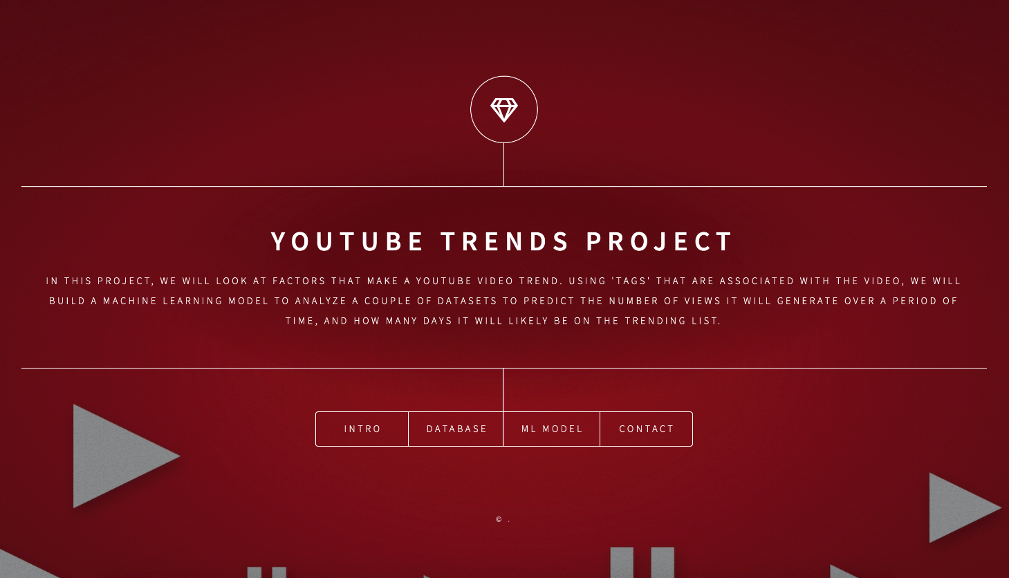

Slide 2
Youtube Trending
In this project, we will look at factors that make a Youtube video trend. Exploring the statistics of TrendingYouTube videos to find what makes these videos so popular, and analyze what are the main characteristics of the most popular videos on YouTube. Using 'tags' that are associated with the video, we will build a machine learning model to analyze a couple of datasets to predict the number of views it will generate over a period of time, and the category of video based on the specific tag words.

Slide 3
Why We Select Youtube Trending
New challenges and new opportunities. Make what they do and the world better. Impact Understanding. The more views, likes or followers the youtubers get, the more popular the channel will be and the higher the opportunity for them to become Trending in the YouTube community. Business Understanding. Each Youtuber is a powerful opportunity to build new products, services, campaigns, brands and more that people will love in 2021 and beyond.

Slide 4
Source of data
We used a dataset from Kaggle that contains statistics of some top trending YouTube videos. Here is the link to the dataset: Trending YouTube Video Statistics | Kaggle In order to make our analysis more accurate and relevant, we only focused on US and UK videos, reducing the dataset’s size to 45k rows and 16 columns. Following is a detailed description of the 16 columns

Slide 5
Technologies Used
Data Cleaning and Analysis Pandas will be used to clean the data and perform an exploratory analysis. Further analysis will be completed using Python. Database Storage Postgres SQL is the database we intend to use. Machine Learning SciKitLearn is the ML library we'll be using to create a classifier. Our training and testing setup is categorizing number of views into groups (target variable: y) and the tag names as our independent variable (features: X). We currently plan to use random forest model to predict the trend. We will also use Naive Bayes to predict the category ID based on the tag. Dashboard We currently plan to use tableau to create a dashboard and Google slides to create the final presentation.

Slide 6

Questions To answer with the data
By the end of this section, your audience should be able to visualize:
What What is the pain you cure with your solution?
Who Show them a specific person who would benefit from your solution.

Slide 7
Limitations and benefits
By the end of this section, your audience should be able to visualize:
Unexpected Highlight what’s new, unusual, or surprising.
Sample Provide a simple unifying message for what is to come

Slide 8
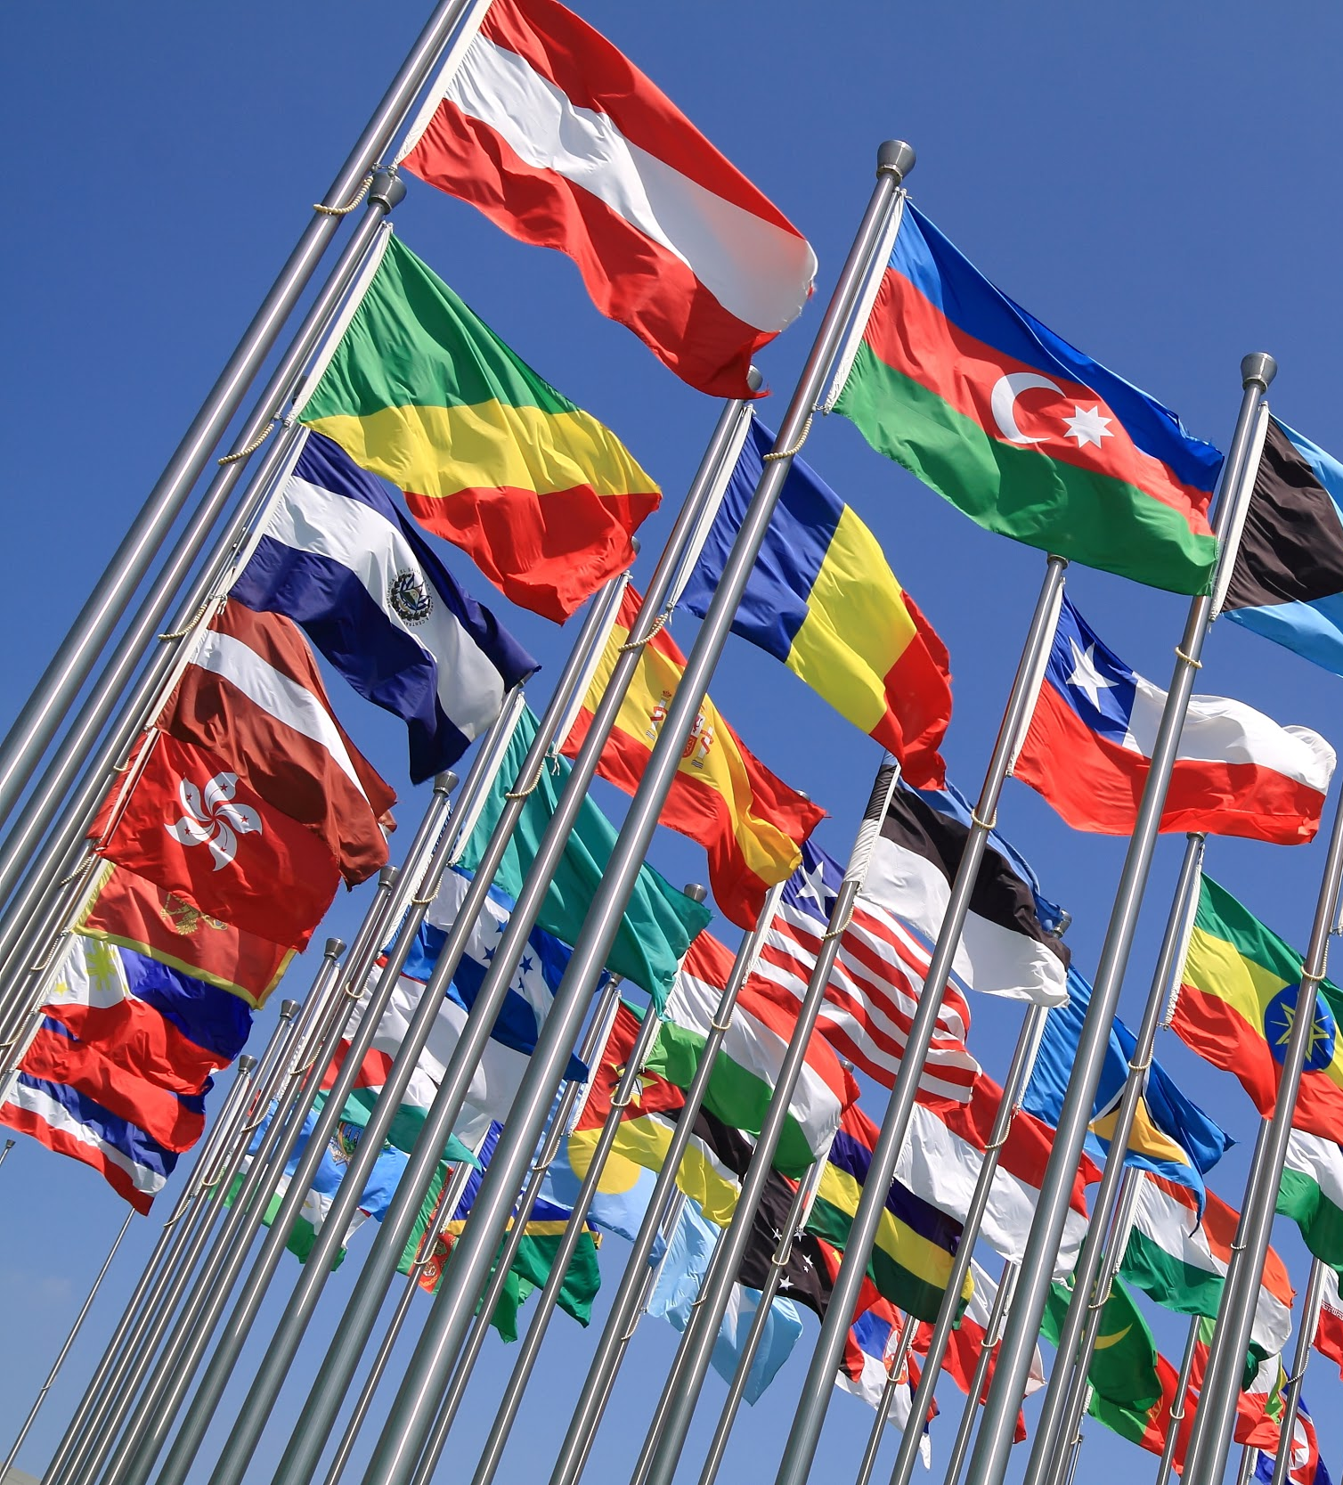

Slide 9
Milestones
2020
January 2021
2020 |  |  |  | 2021
watch

Slide 10

4. Closing
Build confidence around your product or idea by including at least one of the these slides:
Questions What has been accomplished and what might be left to tackle?
Answers Who supports your idea (or doesn’t)?
What’s next? How can the audience get involved or find out more?

